Slide 1
WeTest - Tests automation utility for EPICS
Novembre 5th 2019
Francis Gohier

Slide 2
Table of contents
Part I – User point of View
Part II – Behind the scene
Needs and History
Principle
Writing a scenario file
Execution and GUI
Test results Report
DEMO
Implementation Architecture
File reading and validation
CLI and GUI communication
Naming validation
PDF Report generation
Other changes planned
WeTest development workflow
Sharing WeTest

Slide 3
Needs and History
Principle
Writing a scenario file
Execution and GUI
Test results report
Part I – User point of View

Slide 4
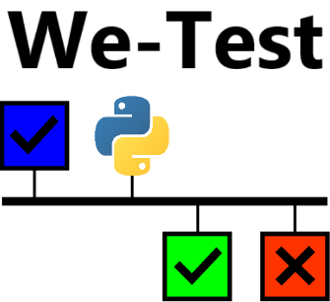




Needs and History
Main objective : Automate Acceptance Tests
prepare tests beforehand
test are executed automatically rather than manually
therefore the same tests can be replayed over and over again
automatically generate a proper test report
History
In 2014 WeTest prototype written by J-F. Denis: scripts to execute tests described in CSV files and generate a PDF report
In 2016, N. Senaud implements WeTest, using YAML files instead of CSV
In 2017, Injector delivery at Catania (Italy) for ESS (European Spallation Source)
Development and Maintenance handed to F. Gohier, in 2018
In 2018 not used for a delivery because lacking features to test process
Adding GUI (Graphical User Interface) in 2019, based on work by V. De Menezes
Adding Macros support (variable substitution) in 2019
Used in 2019 for ESS nBLM acceptance tests at Saclay (France)
Tests are being written for deliveries in 2020 for SARAF and IPHI projects

Slide 5
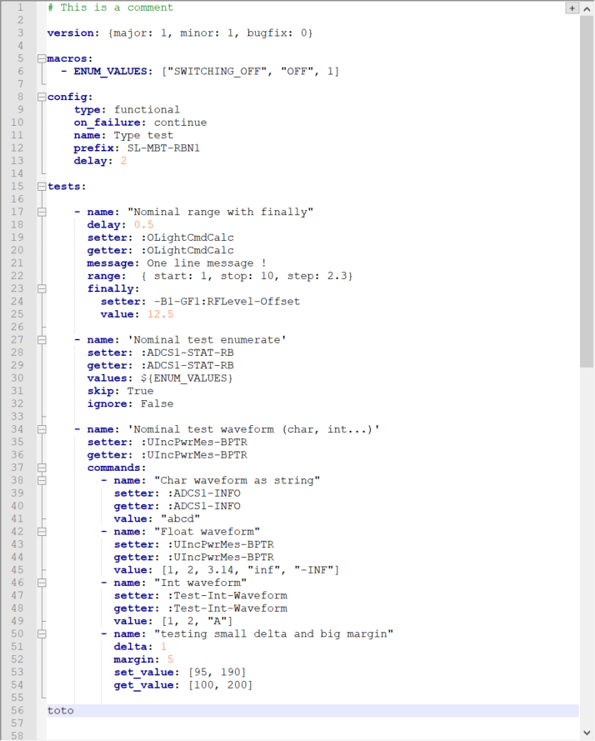

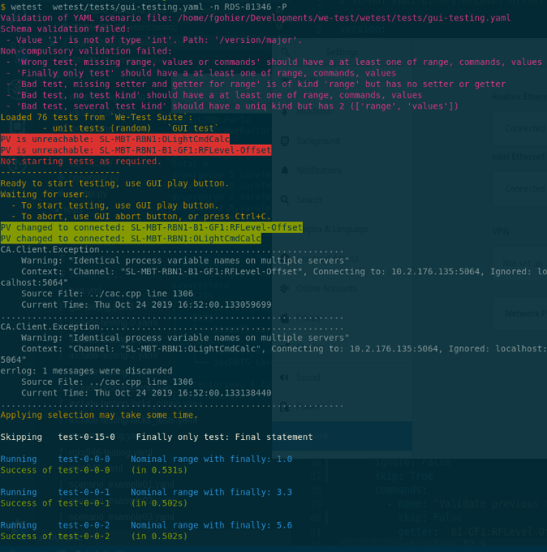
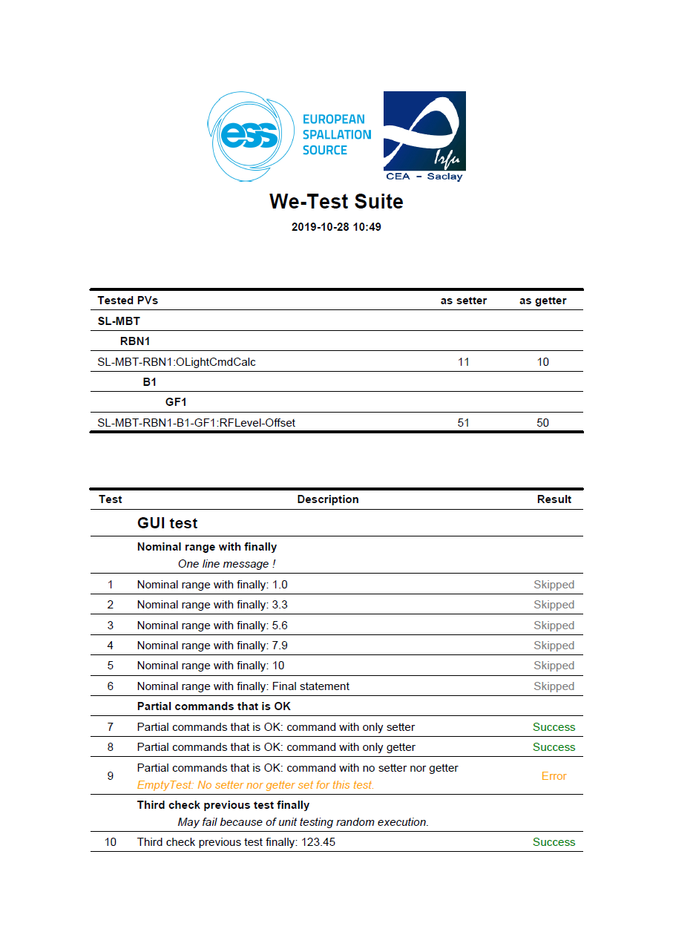


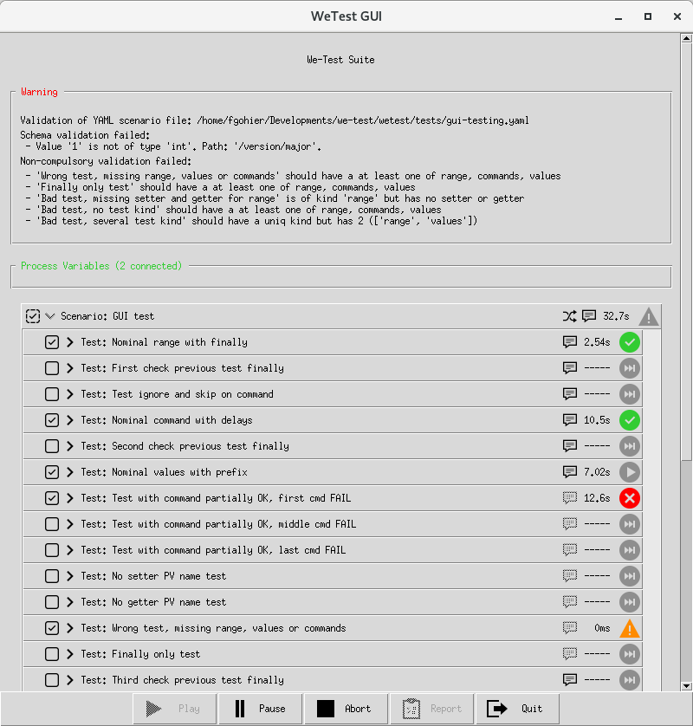
Principle: Overview
Tests are described in a YAML file
Executed in CLI with or without GUI
a PDF report is generated
YAML is a human-readable data-serialization language (close to JSON)
GUI can be deactivated to work on computer without a graphical interface
The PDF report is a clear, dated and readable account of the executed tests and their result

Slide 6
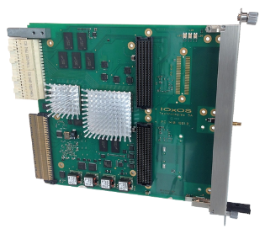

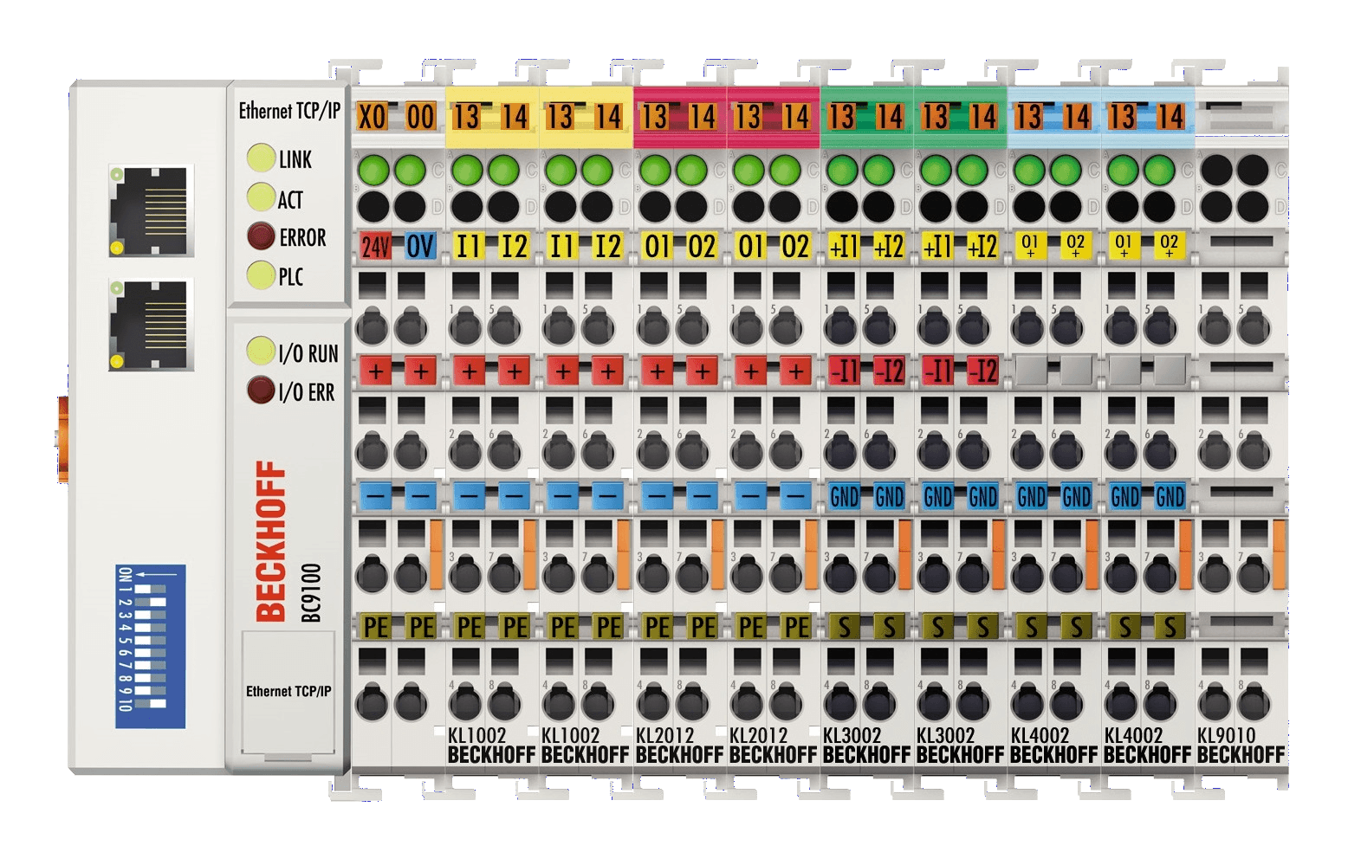
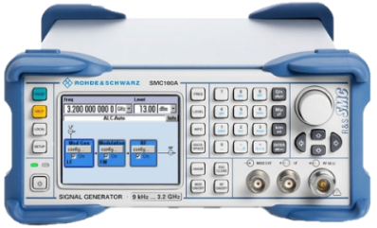
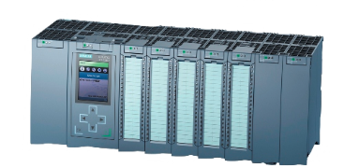
Principle: EPICS PV testing through CA and other vocabulary
WeTest sets and checks the values of EPICS Process Variables (PVs) via the Channel Access (CA)
WeTest executes subtests contained in a suite
A suite is composed of one or several YAML file called scenarios
Tests are defined in these scenarios, each test generates one or several subtests
A subtest can set the value of a PV, wait for a given delay, read the value of a PV and check it against expected values
Subtest result is one of : skipped, success, failure or error
The subtest fails if it can not write the value or if the value read does not match the expected value
A subtest errors when it is not written properly
EPICS Chanel Access
caput
caget
IOC
IOC
Devices network

Slide 7
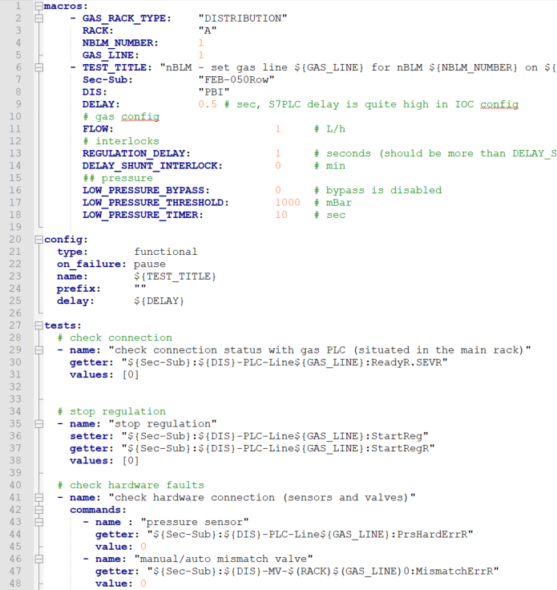
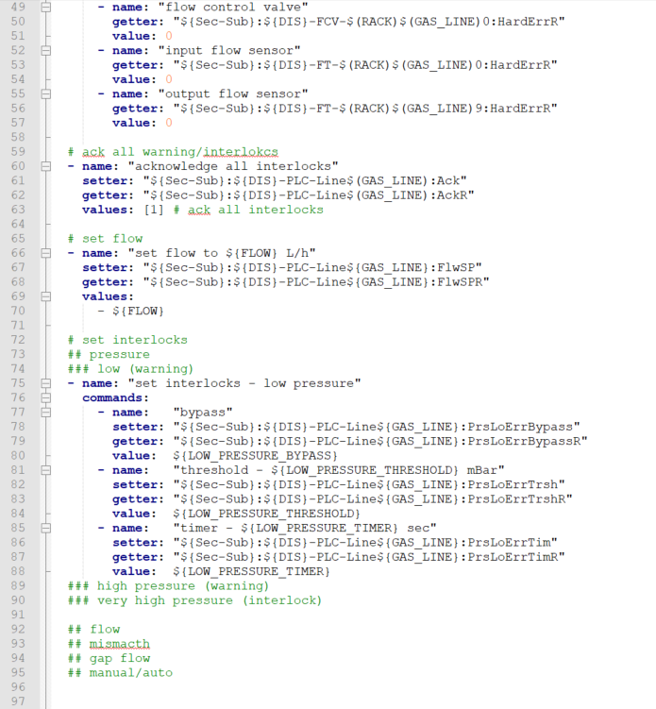
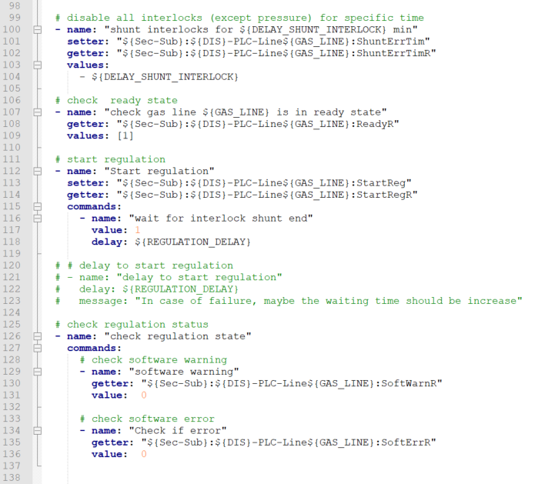
Writing a scenario file : Example – Partical use
One of the scenario written to test a gas line on ESS nBLM project
Another scenario calls it multiple time to substitute the different gas lines identifiers

Slide 8
Writing a scenario file : YAML syntax
Comments start with a hashtag (#)
Uses indentation for multiline content
Composed of maps and sequences (aka. dictionaries and lists)
Lists are composed of items starting with a dash (-)
Maps are composed of items with a key and a value separated by a colon (:)
Needs a space after dash and colon
One-line form is available using:
square brackets ([]) for list
curly brackets ({}) for maps
comas (,) to separate items
String are found automatically or using quotes (“”)
Some strings are read as Booleans: True, False, Yes, No

Slide 9
Writing a scenario file : Tests block
tests block lists all the tests to execute each test generates one or more subtests
A test has a test kind (range, values or commands) and a setter and/or getter PV (EPICS Process Variable)
Some fields are common to all tests kind
name, message, prefix, use_prefix, delay, setter, getter, margin, delta, ignore, skip, on_failure, retry
range: to test many numerical values
start, stop, step, lin, geom, includes_start, include_stop, sort
values: hand-picked values and not only numerical
list of values (float, int, bool, enum, string or waveform)
commands: set all the parameters of each subtest
name, message, delay, setter, getter, set_value, get_value, value, ignore, skip, on_failure and retry
finally: sets a value after at the end of the test

Slide 10
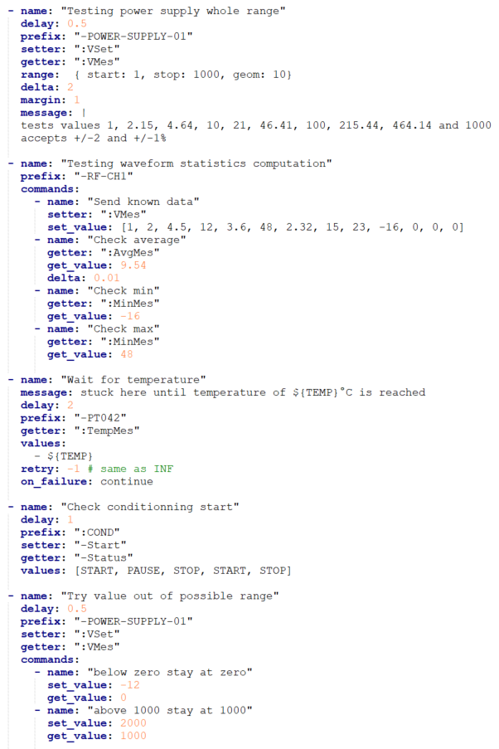
Writing a scenario file : Example - Use Cases
tests hardware range of values
test multiple enum values
tests min a average computation off a waveform
test controller refusal
wait to reach given condition

Slide 11
Writing a scenario file : Config block and Version
config block configures the scenario’s tests block
name in the config block corresponds to the scenario name
type determines if the scenario’s tests are “functional” or “unit”.
Unit tests are shuffled to be executed in random order (yet the subtests stay in the same order within each test)
prefix will be prepended to each test’s prefix
other fields define the default fallback value to use when these fields are not defined in a test.
use_prefix, delay, ignore, skip, on_failure and retry
version, at the root of the file, is mandatory and used to check that the file is compatible with the version WeTest reading it.

Slide 12
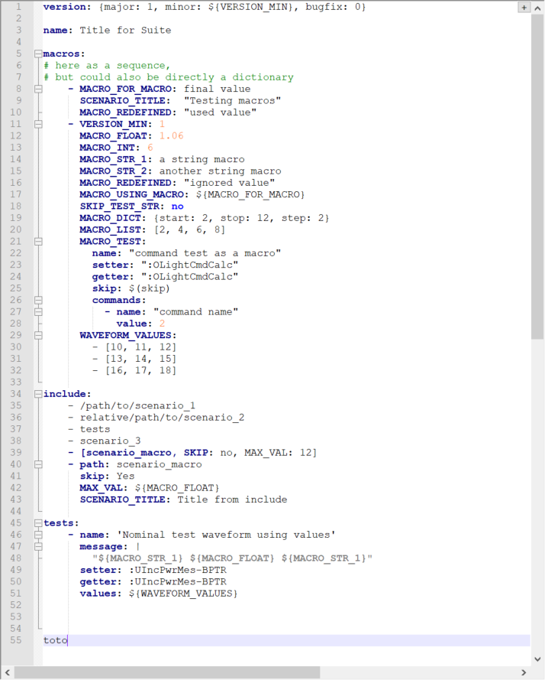
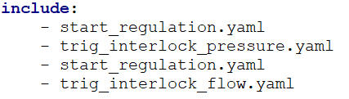
Writing a scenario file : Include block and suite name
include block enables to insert other scenarios before or after the tests defined in this file
Included items must specify a file name or path
filepath resolution order is: absolute path, then relative to execution location, then relative to current scenario location
Tests position in the include sequence is by default at the end, but can be changed by using the “tests” include keyword
A scenario file can have no tests and config block and only an include block (as well as a version).
macros can be changed in the include line
(see next slide for more information about macros)
name, at the root of the file, is used as the suite name.
Only the name defined in the topmost file (the one that is first read by WeTest and includes the other scenarios) is used, the other ones are ignored. This field is optional.

Slide 13
Writing a scenario file : Macros block
macros block enables to define a kind of variable with a name (string) and a value
macro value can be a simple type by also maps and lists
macros are set in the macros block
macros can also be set in the include block
and have priority over macros defined in the included file
The value of a macro is substituted anywhere in the file where $(MACRO_NAME) or ${MACRO_NAME} is used
macros can be used in the macros block
but should be defined before hand (previous item in the macros block as a list, or from include call)
Limitations
dash (-) and colon (:) in a string value, are in some specific cases interpreted respectively as a list or as a map
it is not possible to force a value to be interpreted as a string (however one can use the macro in a string with a space for instance)

Slide 14
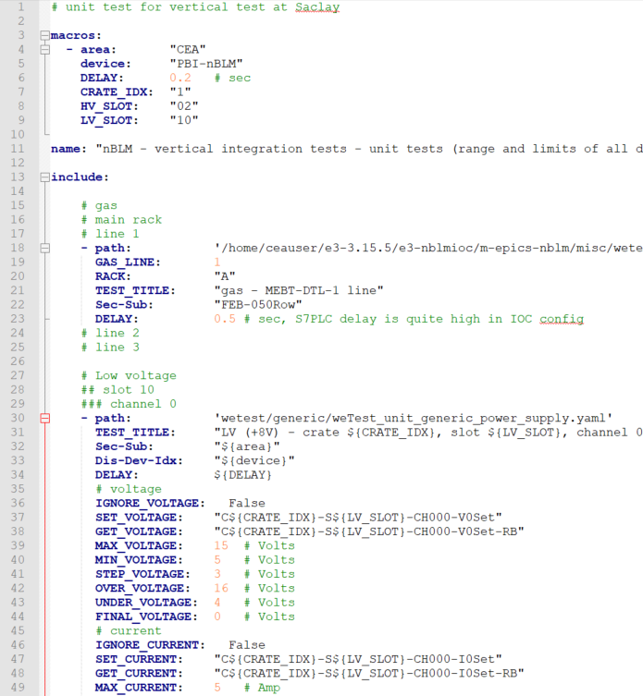
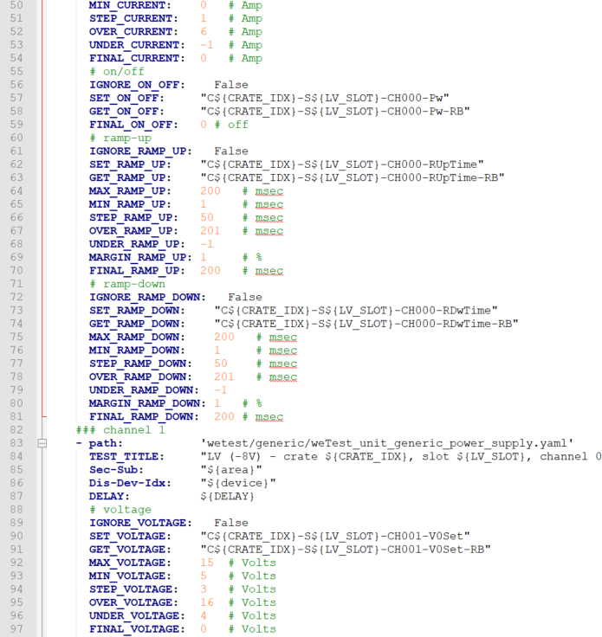
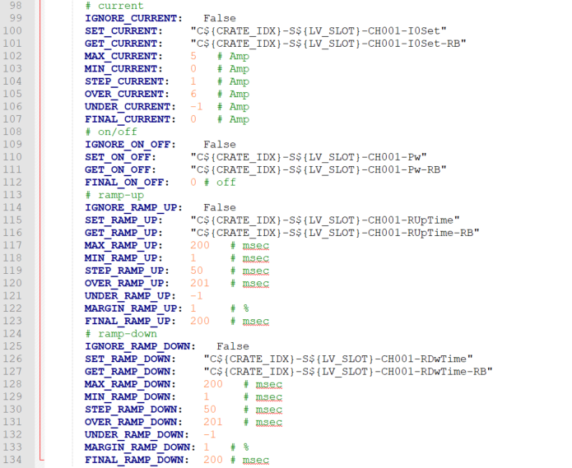
Writing a scenario file : Generic scenarios
Generic files are shipped with WeTest for instance to test a power supply
Here the generic file is included for each of the twenty lines of ESS nBLM, after an initial setup

Slide 15
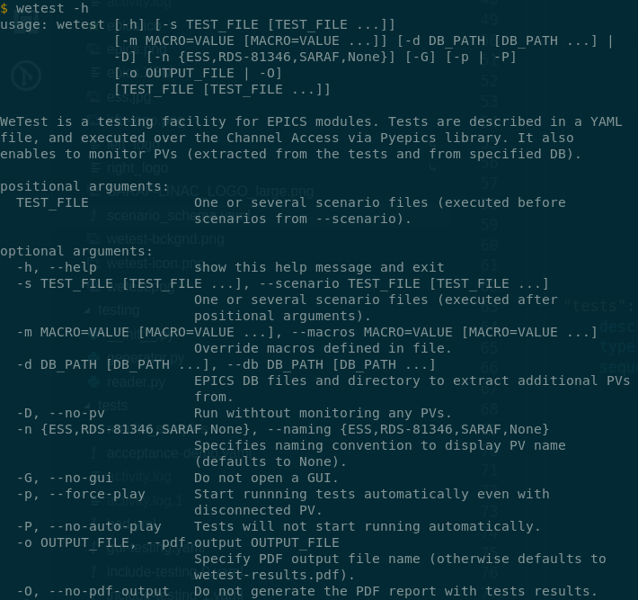
Execution and GUI: CLI options
Currently WeTest can only be run from CLI
Options relative to tests definition
one or multiple YAML scenario files can be given using positionnal arguments or -s, --scenario option
-m, --macros to change macro value
Options relative to PV
by default PVs list is created from subtests list
-d, --db option to enter EPICS DB directory or files
-n, --naming to choose naming rules validation (ESS, RDS-81346, SARAF, None)
-D, --no-pvs to deactivate PV monitoring
Options relative to report
-O, --no-pdf-output to deactivate report creation
-o, --pdf-output to change output report name (default to wetest-results.pdf)
Other options
-G, --no-gui to show execution and results only in CLI
-p, --force-play to start testing even if some PVs are deconnected
-P, --no-auto-play to wait for user input before running tests even if all PVs are connected
Examples
wetest -h
wetest ./path/to/scenario
wetest -d /path/to/DB -n SARAF -ps ./path/to/scenario -o report_name
wetest ./path/to/scenario -DPGO --macros SKIP=True SCENARIO_TITLE=“Title from CLI”

Slide 16
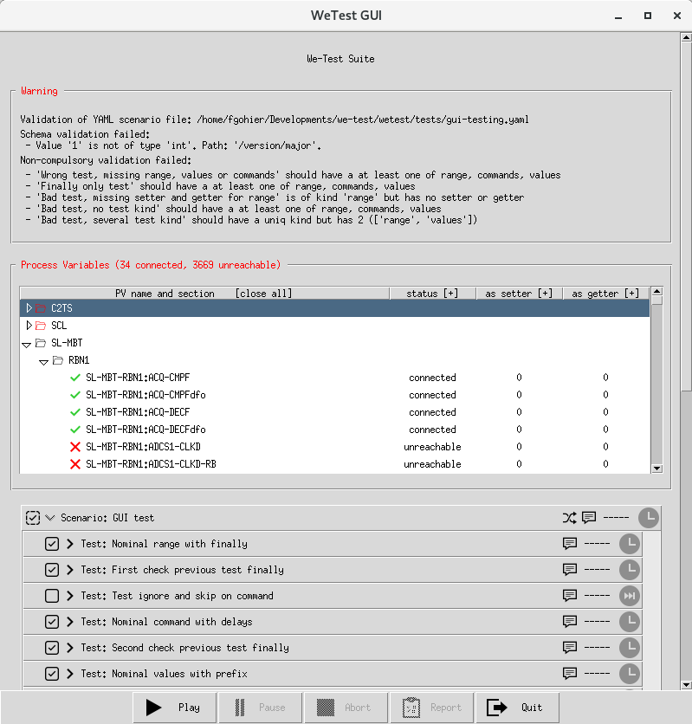
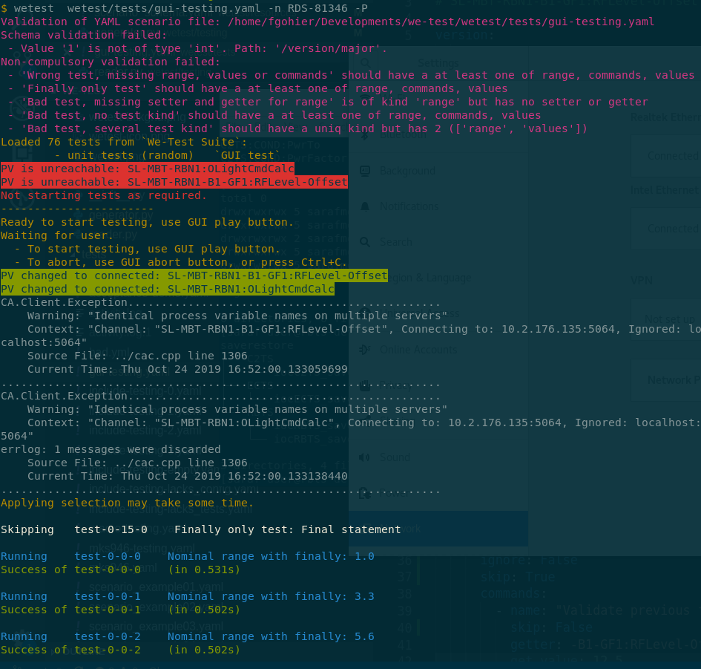
Execution and GUI: Warning section
Warning section
shows only when scenario files contains errors
collapsable by clicking on warning outer border
first check for basic schema validation (fields names and type)
second check for higher level validation (complex types or relations between fields)
third is no-go validation (WeTest can not work with these inputs)

Slide 17
Execution and GUI: PVs checking and monitoring
PVs are checked against to the naming provided
an invalid naming section is created to show erros
PVs connection status is monitored
much more convenient in GUI than in CLI
Additionnal features available in GUI
move around and collapse/expand sections
click first column title to collapse all sections
click other column title to apply filter
filter to show only disconnected
filter to show only tested PVs
Two display modes
short mode: table only appears when there are disconnected PVs
full mode: table shows in anycase and uses three-time more space
toogle mode by clicking on Process Variables outer border

Slide 18
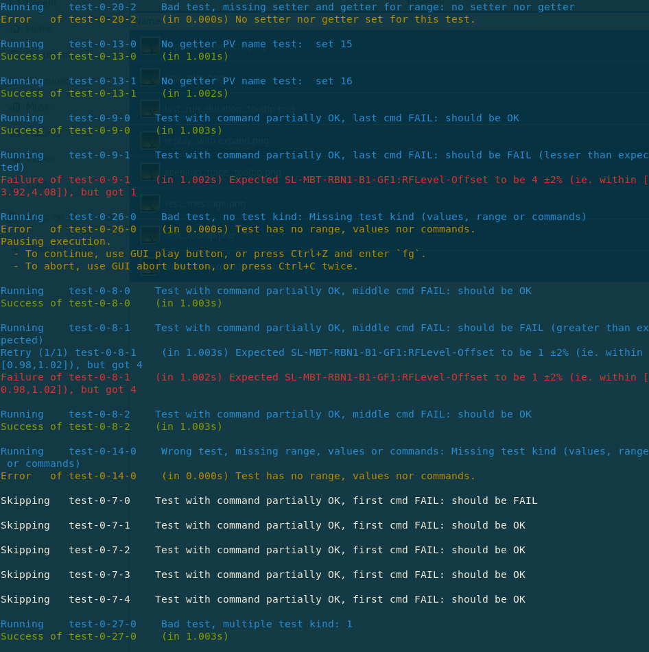
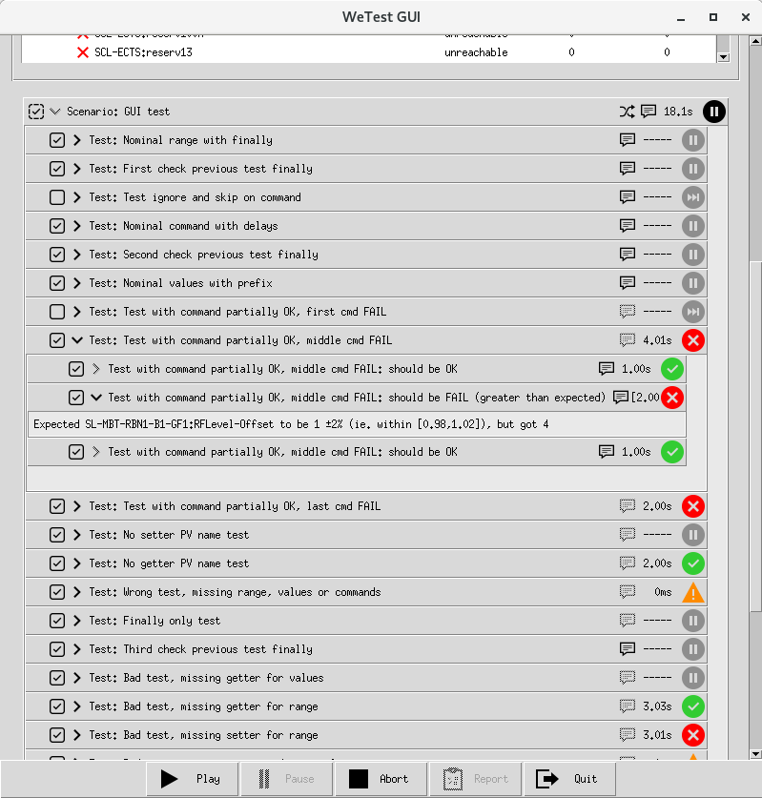
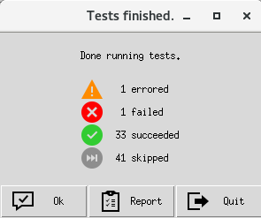
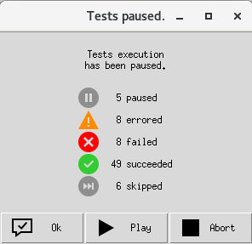
Execution and GUI: Execution and Results
Control bar at GUI bottom
start or resume testing
pause the tests temporarly
abort the testing (no report can be generated)
open latest report
quit GUI and abort tests
note that tests can also pause or abort automatically with on_failure field value
Pause and Abort available in CLI as well
start using Ctrl+D and Enter
abort using Ctrl+C
pause using Ctrl+Z
resume using Ctrl+Z and `fg`
GUI pop-up with results summary
when pausing (either user or test)
when aborted or finished
GUI tests treeview
collapse/expand from scenarios to subtests
collapse/expand all by clicking status icon
expand subtest to see its failure or error traceback

Slide 19
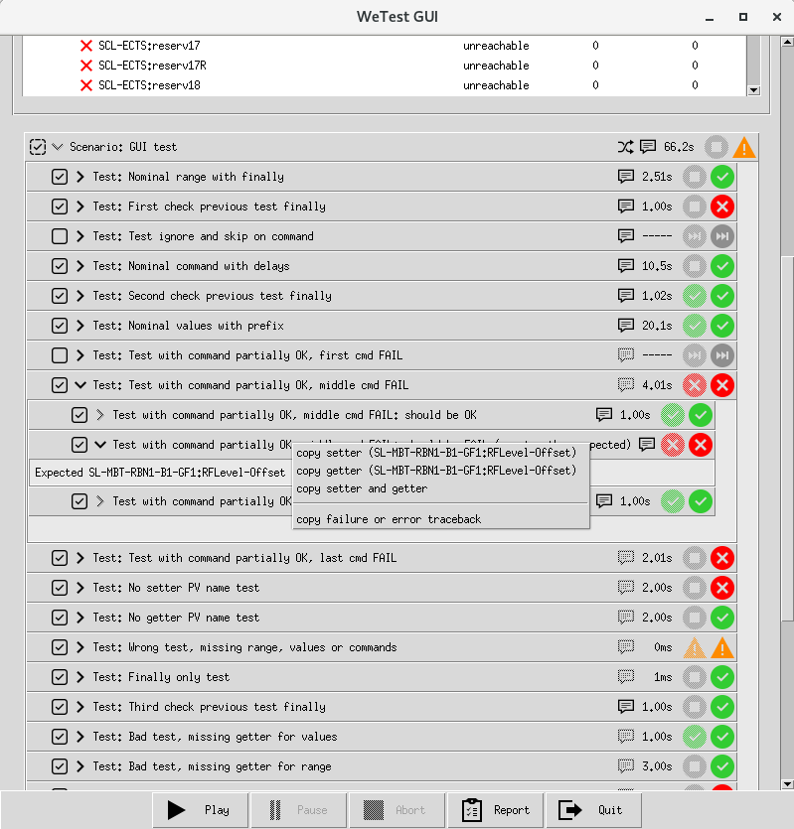
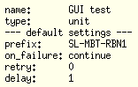
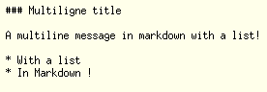
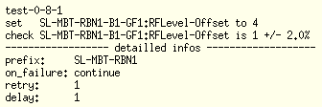
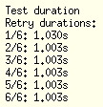
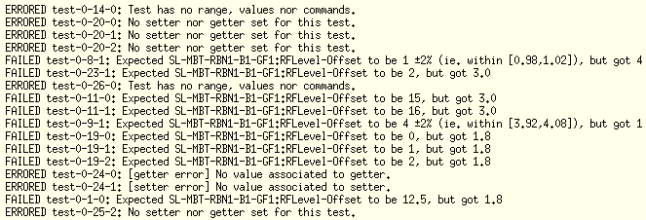
Execution and GUI: Additional GUI features
Selection (preset according to skip field)
can select which subtest to execute
can select whole or partial scenario and test as well
Replay
previous icon status still shown with its traceback
selection change during run is only applies at next run
Multiple tooltips
hover above scenario to see config
hover above test to see message
hover above subtest to see set and expected values and other parameters
hover above test duration to see retry details and previous run duration
hover above status icon to see traceback summary
Copy to clipboard
by right-clicking on subtest
enable to copy setter, getter or all PV names (to use for instance with caget or camonitor in CLI)
enable to copy traceback if any

Slide 20
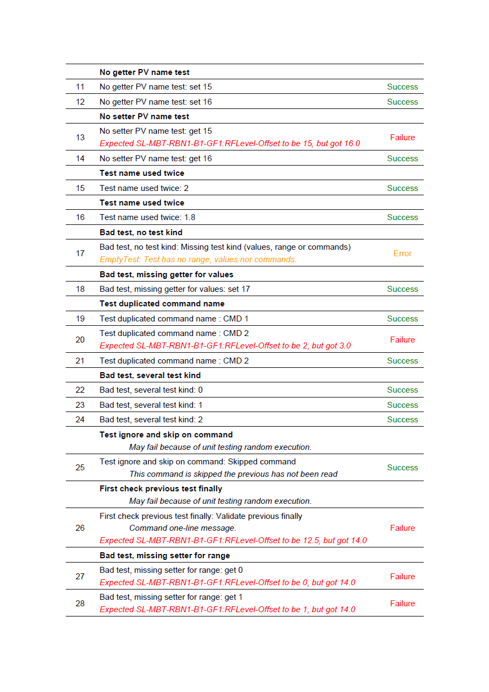
Tests results Report
A PDF report generated automatically
see CLI options to change name or deactivate
PV table shows tested PVs
sorted by section if a naming option was provided
shows number of time PV is used as setter or getter
Informations displayed
Suite, scenario and test title and messages
Subtest title, message, status and traceback
Informations NOT displayed (yet ?)
subtest number of retries, duration and execution date
Four possible test status
success when test matches expected outcome
failure when test outcome different that expected (the device did not react as expected)
error when test did not execute properly (something is wrong with the test written)
skipped when test not executed (test skipped in file or not selected in GUI, since the report is not generated at all when tests are aborted)

Slide 21
DEMO

Slide 22
Implementation Architecture
File reading and validation
CLI and GUI communication
Naming validation
PDF Report generation
Other changes planned
WeTest development workflow
Sharing WeTest
Part II – Behind the scene

Slide 23
Implementation Architecture: Previous version (before 2019)
Readers (use pykwalify and yaml modules)
generate a tests_data dictionnary with file content
TestsGenerator
generates test_data for each subtest
test_generator function
converts test_data into executable function that are added to the TestSuite
XMLTestRunner (inherits TestTextRunner)
executes TestSuite and generates tests_results
ReportGenerator (use reportlab module)
builds a pdf from the tests_results
Suite YAML file
SuiteReader
tests_data
Scenario YAML file
ScenarioReader
TestsGenerator
Schema YAML file
pykwalify .Core
TestData
TestData
TestData
yaml .load
test_generator
unittest .TestTextRunner
reportlab .platypus
unittest .TestSuite
xmlrunner . XMLTestRunner
tests_results
ReportGenerator
Limits
Not really needed to distinguish between a scenario and a suite
XMLrunner is a 3rd-party libary aimed at generating xUnit XML file that we don’t use
Report
XML file
Report
PDF file

Slide 24
Implementation Architecture: Current version (end of 2019)
SelectableTestSuite
a TestSuite with optimized select/skip feature
also stores tests data for GUI and report
PVsTable (uses pyepics module)
monitors connection status via callbacks
Multiprocessing
main process is dedicated to GUI
another to run the tests and generate report
another to analyse the tests output & update GUI
another to apply requests from GUI
multiprocessing queue used to convey data
colorlog module used for nicer CLI logging
Scenario YAML file
ScenarioReader
tests_data
Schema YAML file
pykwalify .Core
TestsGenerator
TestData
TestData
yaml .load
TestData
MacrosManager
test_generator
unittest .TestSuite
SelectableTestSuite
ProcessManager
colorlog .ColoredFormatter
reportlab .platypus
GUIGenerator
PVsTable
unittest .TestTextRunner
tests_results
ReportGenerator
GUI
queue_from_gui
parse_commands
logging .logger
Report
PDF file
queue_to_gui
parse_output
runner logs

Slide 25
Implementation Architecture: Future version
Custom QueueRunner
sends test results live to provided queues (no more unatural mechanics through logger)
manages on_failure and retries (today done within test function)
Generate intermediate report file
to build a report in case of abort
to generate report later
to generate multiple kind of report (xUnit ?)
Scenario YAML file
ScenarioReader
tests_data
Schema YAML file
pykwalify .Core
TestsGenerator
TestData
TestData
yaml .load
TestData
MacrosManager
test_generator
unittest .TestSuite
SelectableTestSuite
ProcessManager
colorlog .ColoredFormatter
reportlab .platypus
GUIGenerator
PVsTable
QueueRunner
Report
YAML file
ReportGenerator
GUI
queue_to_gui
parse_output
Report
PDF file
queue_from_gui
parse_commands

Slide 26
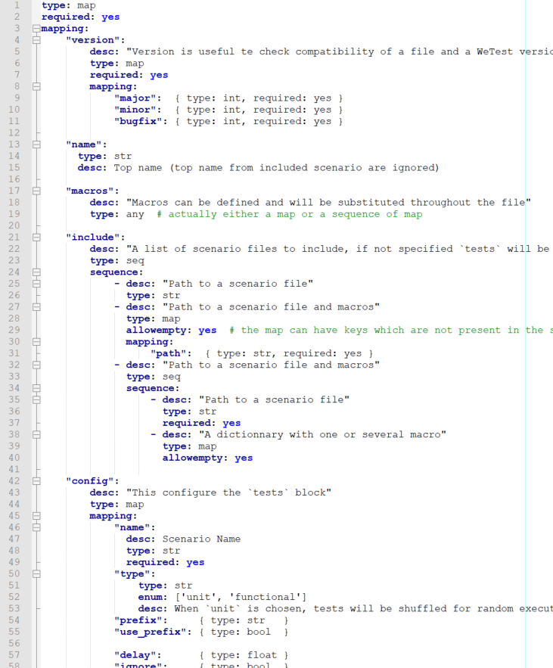
File reading and validation
File reading
read using base module yaml
transform the files into a python dictionary
dictionnary is then processed to generate all the corresponding subtests
File validation
a schema is defined to check file content using pykwalify
more complex tests are implemented to test composite fields type and fields compatibility
Macros substitution
done using regex.substitute
therefore every is converted into a string
and is then converted back into float, integers, boolean, dict, list or left as a string if not possible

Slide 27
CLI and GUI communication
Tkinter
supposed to be installed by default with python installation
when not already install should be easilly installable as standard OS package
requires the GUI to be run in the main thread
CLI only mode
is the historic mode for WeTest
this mode is still available using option to disable GUI generation
however WeTest always require Tkinter to be installed (bug #135)
Multithreading
GUI refreshment should not impact test execution therefore using a seperate thread to run tests
tests logs in CLI are captured and convert into GUI updates
GUI pause, resume and abort are convert into actions over the test-running process
PVs changes sent through the same multiprocessing queue to update GUI
SelectableTestSuite
ProcessManager
GUIGenerator
PVsTable
unittest .TestTextRunner
GUI
queue_from_gui
parse_commands
logging .logger
queue_to_gui
parse_output
runner logs

Slide 28
Naming validation
Naming validation
Naming interface defined with sort, split and ssplit (short split) methods to implement
Each naming implements the Naming class
The sort method is used to ensure the PVs are always presented in the same order
The split and ssplit methods are expected to return a list of the PV sections
If a PV name is not valid the split method is supposed to return a NamingError
Naming check can be as strict as desired
Multiple naming strictness for the same project possible as long as the implemented class has a different name.
TODO
enable user to provide custom naming without modifing WeTest code (a sort of plugin) (feature #136)
provided function will need to implement the Naming interface

Slide 29

PDF Report generation
PDF Report construction
The PDF construction is based on the 3rd-party module reportlab
Basic reportlab funtionnalities are used as much as possible to format the page, the paragraphs, the tables and images.
Client en CEA logo are inserted on top of the document (client logo ought to be changeable easily, feature #71)
The first table extracts the PVs from the SelectableTestsSuite and show how many time each PV is tested as a setter and as a getter.
The PVs table is generated using the Naming provided in order to present PVs by section, and to show invalid PVs names.
Tests data stored in the SelectableTestsSuite are recovered and associated to the tests results outputed by the TestsTextRunner
Each test result is then formatted in a table entry
Separated by scenario titles and tests titles and messages
When a test failed or errored its trace is displayed, after being shorten when it maches one of the custom Exception (AssertionError, InconstistantTest, EmptyTest)
For more information about reportlab see Reportlab PDF Generation User Guide: https://www.reportlab.com/docs/reportlab-userguide.pdf

Slide 30
Other Changes Planned
GUI major changes planned
choose all of CLI option from a GUI (feature #134)
sort by execution duration, by execution order and test results (feature #121)
pattern filter for PV name (feature #116)
show number or retry (feature #104) and execution date (feature #138)
traceback text should be wrapped to fit windows width (feature #126)
warn when the Report button aims at an older report (feature #115)
Macros major changes planned
macros block should only apply to current file and not to included files (bug #139)
macros starting with underscore (_) should be considered private to file and not changable
enable user to choose macro type (using yaml basic features ?) (feature #141)
Scenario Schema major changes planned
more mathematical comparison (precision, greater than, lesser than, different) (feature #68)
dynamic finally value (only enter PV name and its value will be restored after test) (#52)
Other open bugs
system slowdown are sometime observed when WeTest has been running for a while (#132)
WeTest subprocess have been observed to keep running when WeTest is closed (#129)

Slide 31

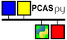




WeTest development workflow
Using Gitlab
as much as possible the issues are fixed and commit one at the time
branches rarelly used (except for major changes) since only one developper
Testing
automatic tests have not been used nor updated for years now (issue #74)
tests are done manually using home-made mockioc script: https://drf-gitlab.cea.fr/epics-tools/mockioc (which accept an EPICS DB an emulate the IOC using PCASpy module)
Update required
write a proper documentation (today only this presentation an README for installation)
update tests (using pytest and doctest when appropriate)
make WeTest python 3 compatible
make WeTest work on Windows
use Continuous Integration with Tox and Gitlab-CI

Slide 32



Sharing WeTest
WeTest plebiscited by users
WeTest well received for delievery in 2017 (Catania) and in 2019 (Saclay)
Answers to an actually need
GUI and macros make it much nicer to use and watch
Retries and pause on failure make it usable to test more complex process
ESS Control team showed interest in using it and maybe participate
Makes writting and running tests more interesting
Automatic testing with WeTest is key for continuous integration of EPICS modules (with actual hardware or emulation via PCASpy or ESS Kameleon simulator)
Required before releasing
proper documentation
proper code testing to avoid regression
proper licensing
open-sourcing code on Github (with transfert of all the issues)
easy installation via pip and conda

Slide 33
Thank you for your attention
Last updated Novembre 5th 2019
Francis GOHIER

